Slide 1

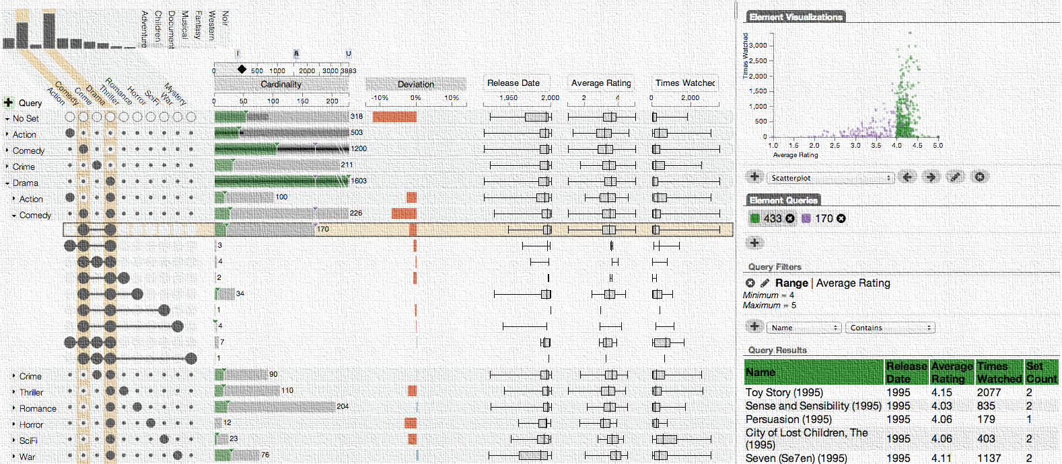
Enabling Scientific Discovery through Interactive Visual Data Analysis
Alexander Lex
@alexander_lex
http://alexander-lex.com
University of Utah
Scientific Computing Institute
December 3, 2014
Notes:
Thank you. Today I will be talking about my research in interactive and visual data analysis.

Slide 2
visualization
pictures
The purpose of computing is insight, not numbers.
- Richard Wesley Hamming
- Card, ‎ Mackinlay, ‎Shneiderman
Notes:
This is a quote that I like a lot by Richard Hamming
The purpose of computing is insight, not numbers.
I truly believe that and not many people would argue against it.
It turns out that this sentence can be adapted to also describe visualization.
The purpose of visualization is insight, not pictures.
Again, this is not a controversial statement.
Yet there are many visualizations and infographics out there that do not enable insight.

Slide 3
Banana
Date
Cress
Rice
Sorghum
Brome
M. acuminata
P. dactylifera
Arabidopsis thaliana
Oryza sativa
Sorghum bicolor
Brachypodium distachyon
Notes:
To give you an example: What do a Banana, Date, Cress Riche, Sorghum and Brome have in common?
They all are plants, and
they all share interesting Latin names.
But they are also evolutionary related. And biologists are interested in how strong this relationship is by analyzing how many genes they share.

Slide 4
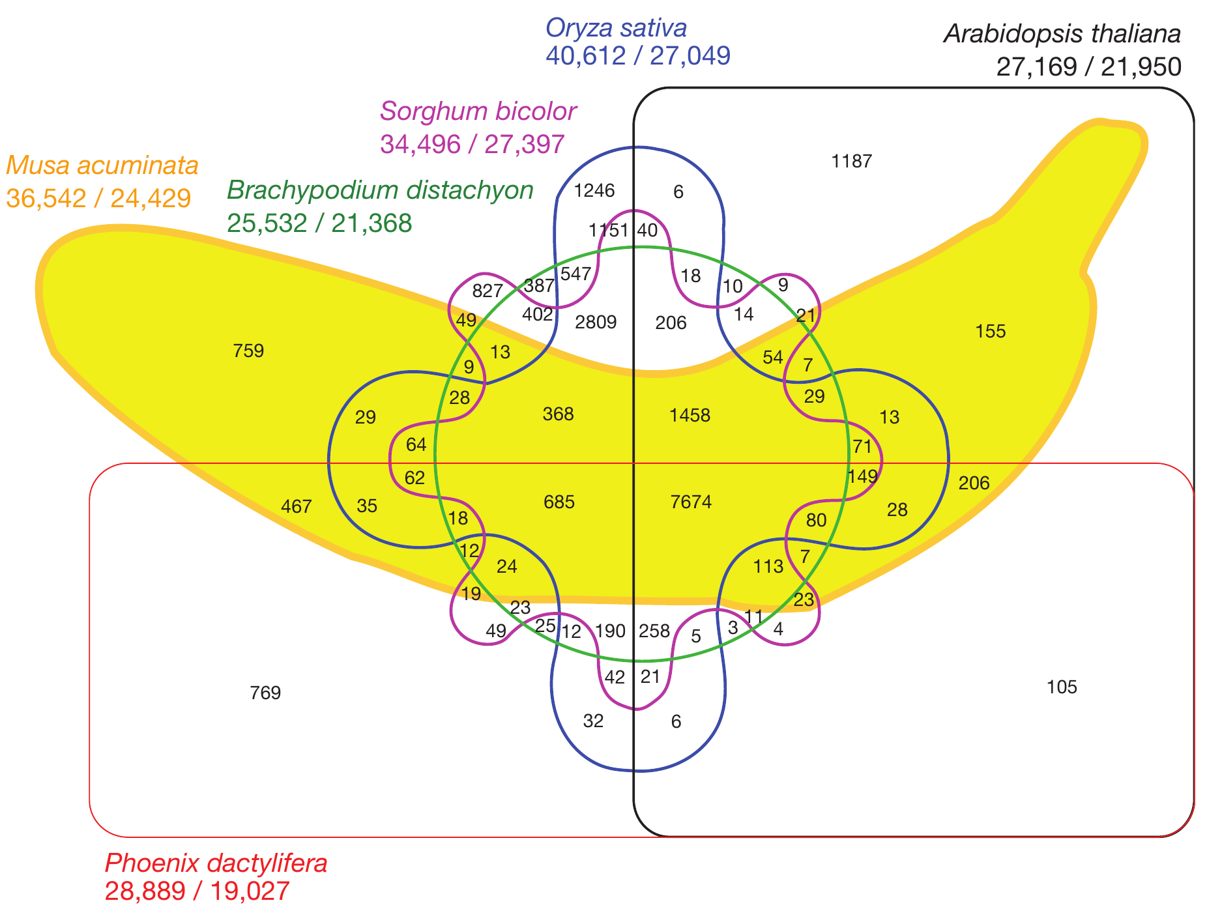
[D’Hont et al., Nature, 2012]
Notes:
In practice, this leads to diagrams like this here
That shows the shared genes of the banana genome and 5 other plant species
You can’t see which intersection is made up from which sets
And this little segment here corresponds to 1151 genes
While this giant segment corresponds to 105 genes
The problem is: you can’t make area proportional venn diagrams for most cases

Slide 5
Good Data Visualization
… makes data accessible
… combines strengths of
humans and computers
… enables insight
… communicates

Slide 6
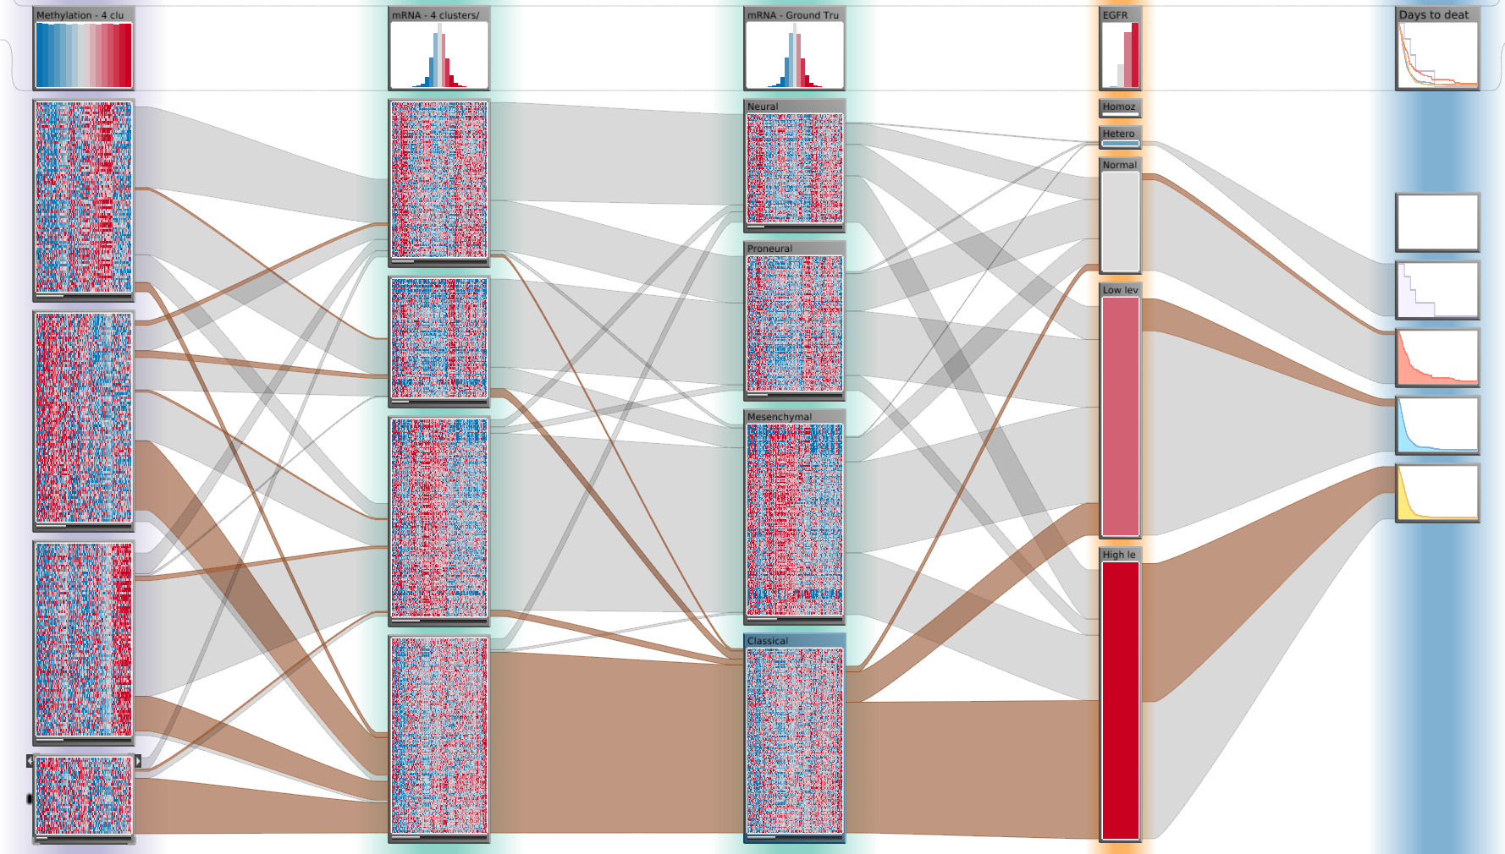
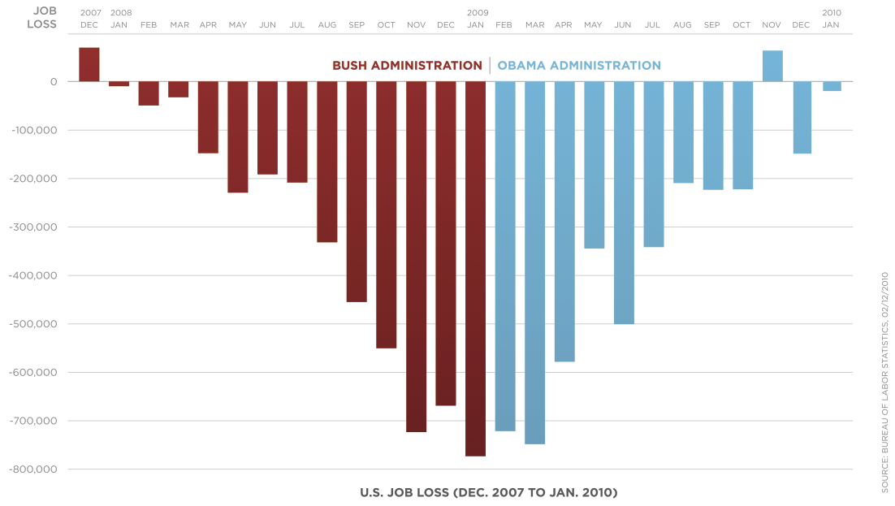
Purpose of Visualization
[Obama Administration]
Open Exploration
Communication
Notes:
Exploration:
result not known
not even question
Illustration:
Know about the data
Communicate to others

Slide 7
Research Approach
Technique Driven
Problem Driven
Solving a general visual analysis problem
Broad application
General questions
  How to visualize many sets?
  How to make rankings interactive?
Visualization Method
Solving a domain problem of collaborator
Complex, targeted systems
Help answer important questions
  What characterizes a cancer subtype?
  Which drug works for these patients?
Visualization Application

Slide 8
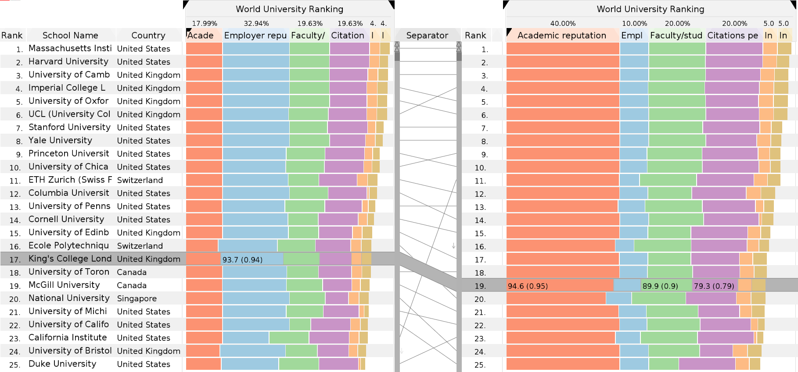
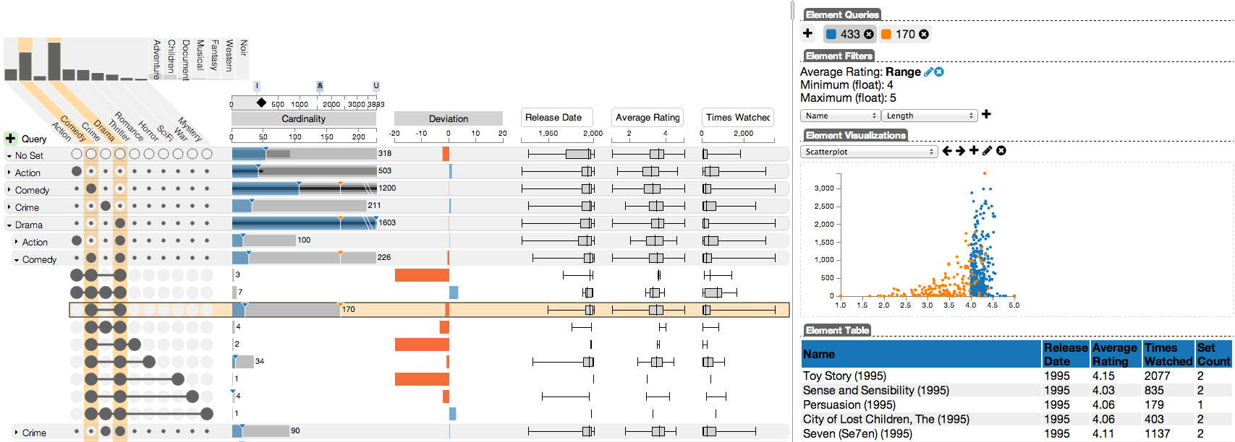
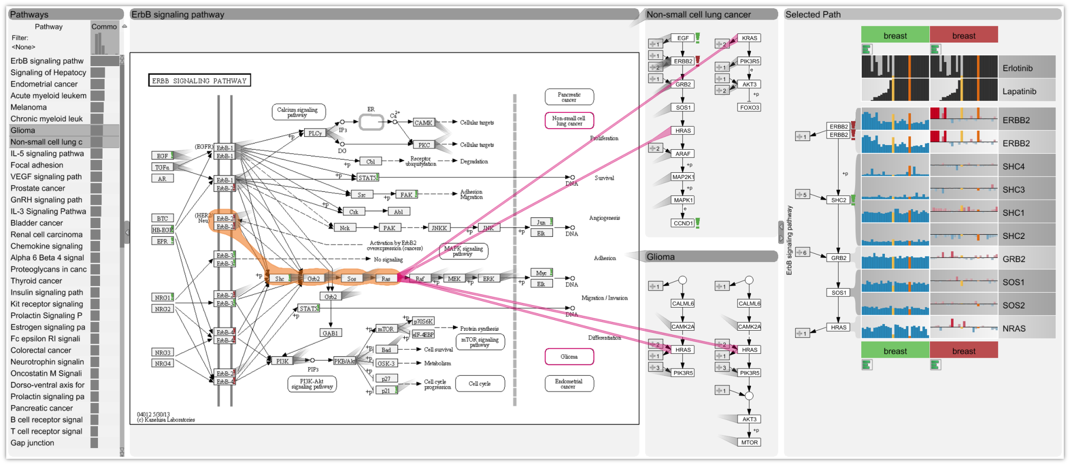
Content
Techniques
Domain Solution
Multi-Attribute
Rankings
Set Visualization
Multivariate Networks
Pathway Analysis
Lay Users
Expert Analysts
Notes:
Order and label
Papers & Conferences

Slide 10
[InfoVis ‘13]
Best Paper Award
Rankings

Slide 11
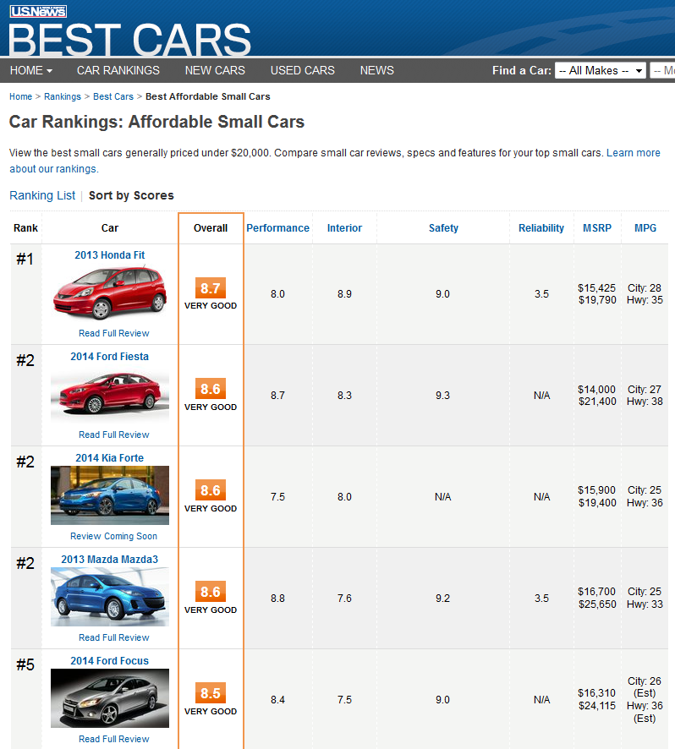
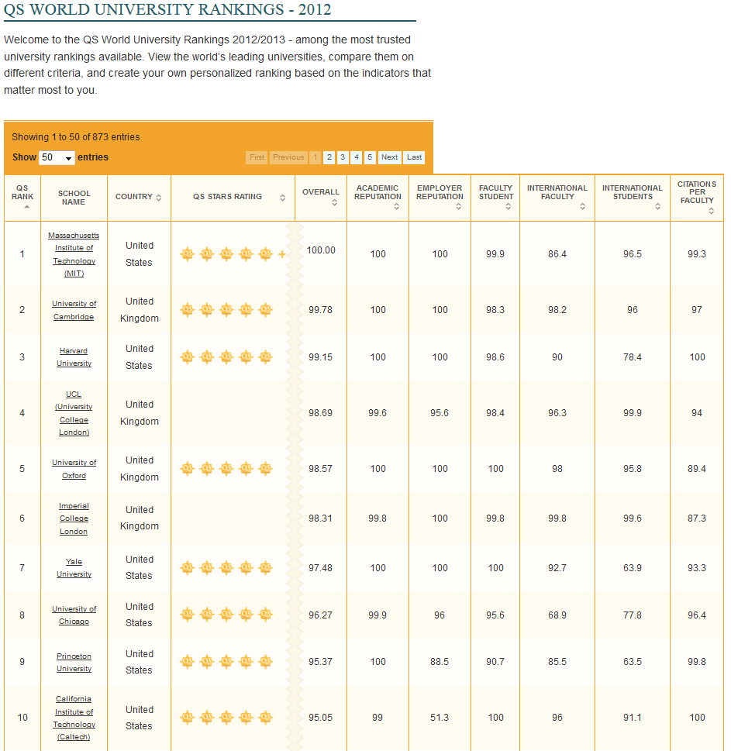
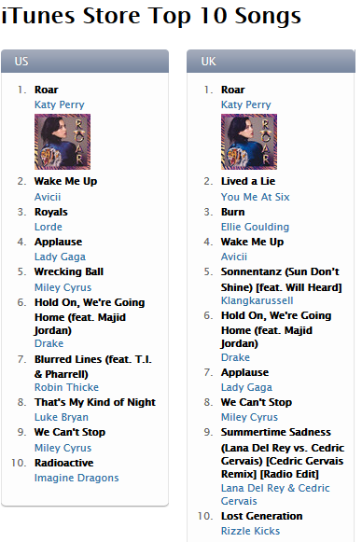
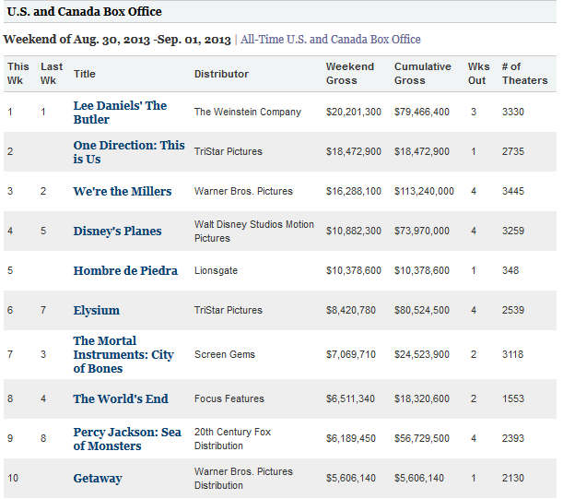
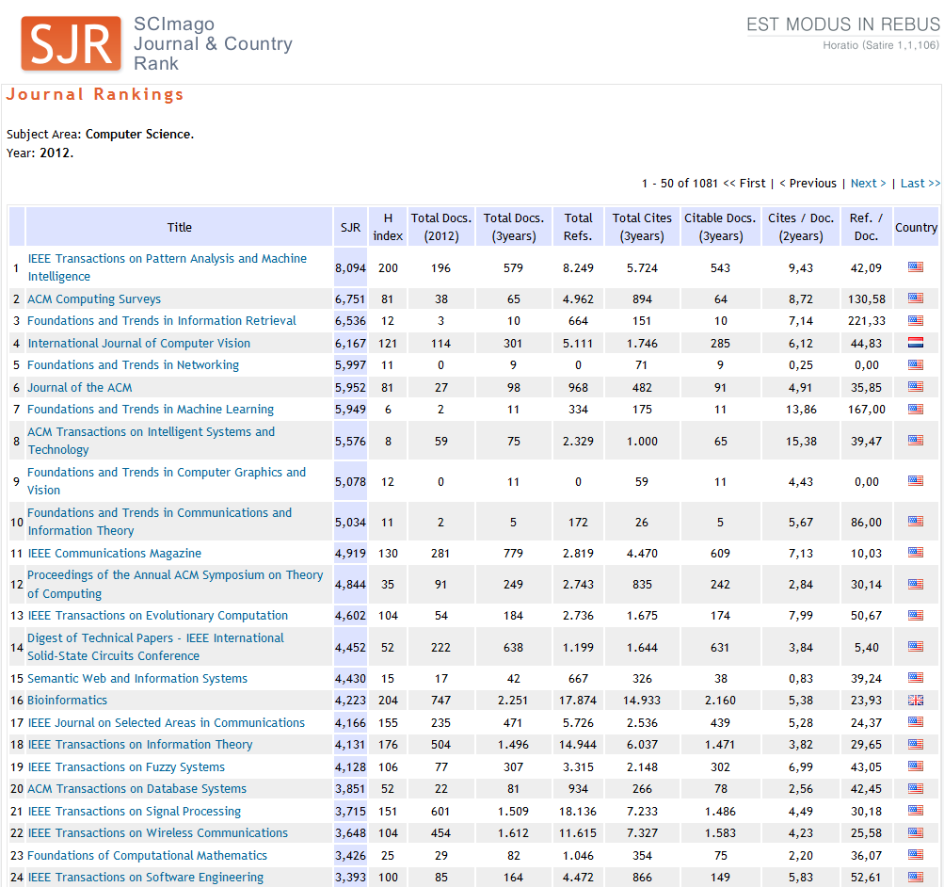
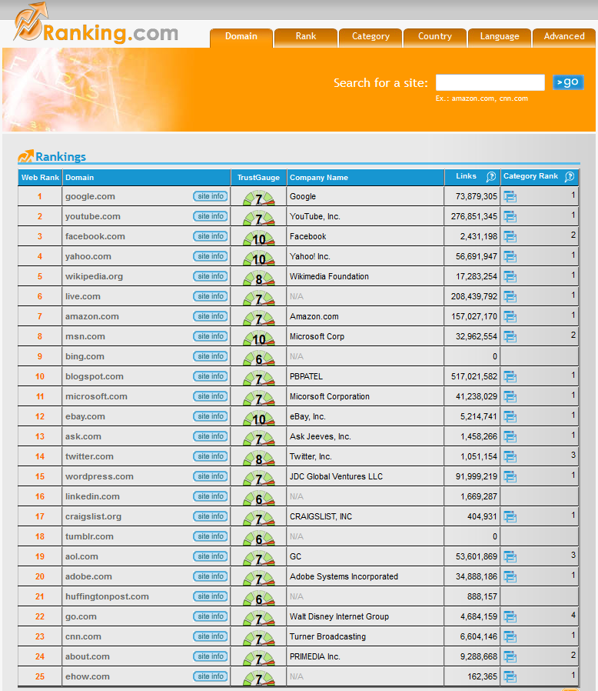
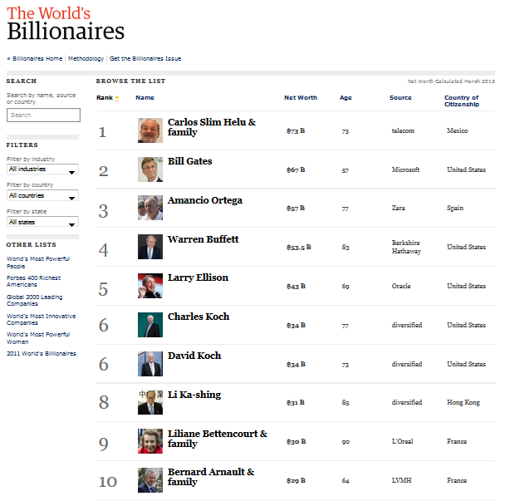
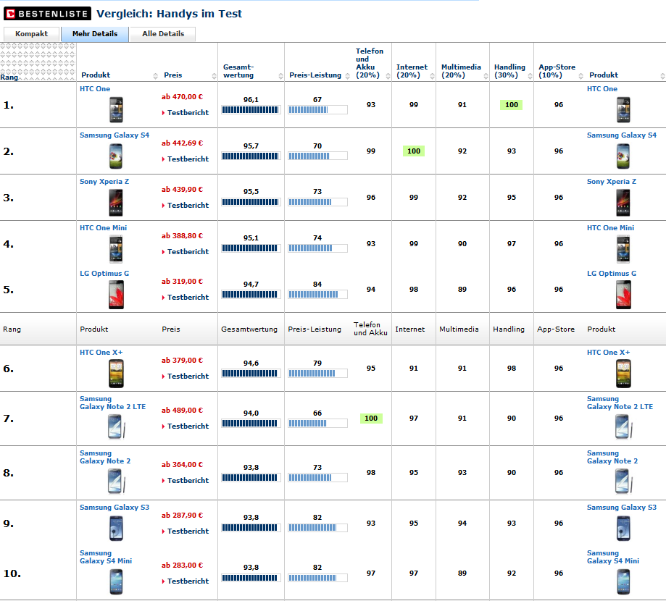
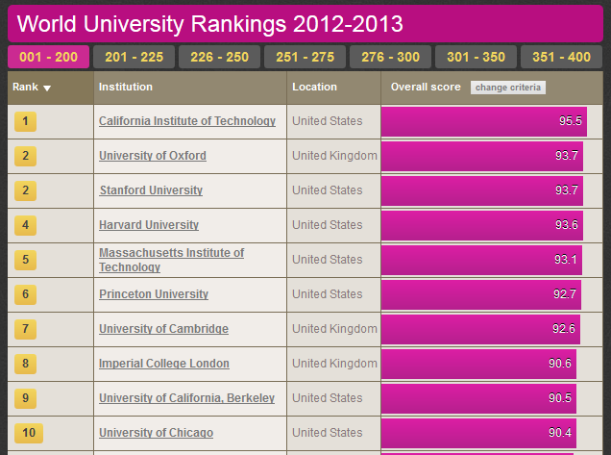
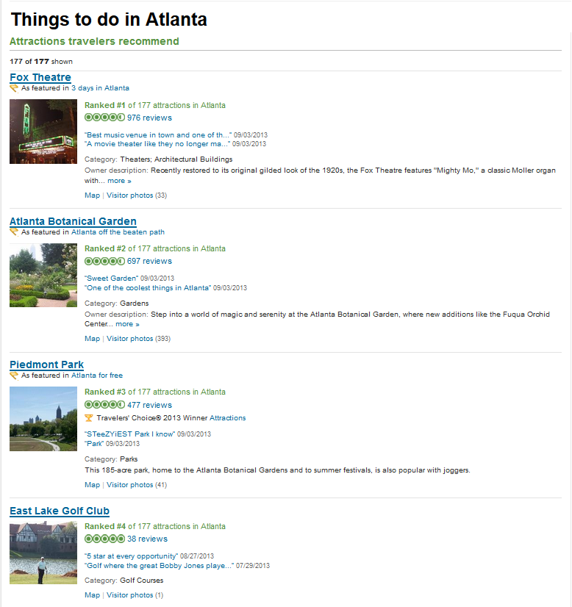
Rankings are popular

Slide 12
Goal
Intuitive
Interactive
Multi-Attribute
Ranking Visualization
To Create
Refine
Explore

Slide 13
Rank
University
Score
Score
1.
MIT, USA
89.4
2.
Harvard, USA
84.2
3.
Princeton, USA
73.8
4.
Cambridge, UK
64.3
5.
Oxford, UK
44.0

Slide 14
Support Multiple Attributes

Slide 15
Score = f(A, B, C)
Rank
University
A
Score
B
C
1.
MIT, USA
2.
Harvard, USA
3.
Princeton, USA
4.
Cambridge, UK
5.
Oxford, UK

Slide 16
Combiner functions: f(A,B,C)
(Weighted) sum
Score = w_{a} A + w_{b} B + w_{c} C
Maximum
Score = max(A, B, C)
Product
Nesting
…
Serial
Parallel
Complex
Combiners

Slide 17
Serial Combiner
(as Stacked Bar)
w_{a} A + w_{b} B + w_{c} C
Rank
University
A
B
C
1.
MIT, USA
2.
Harvard, USA
3.
Princeton, USA
4.
Cambridge, UK
5.
Oxford, UK

Slide 18
Serial Combiner
(as Stacked Bar)
w_{b} B
w_{c} C
w_{c} C
w_{a} A + w_{b} B + w_{c} C
w_{a} A
w_{a} A
+
w_{b} B
+
+
+
Rank
University
A
B
C
1.
MIT, USA
2.
Harvard, USA
3.
Princeton, USA
4.
Cambridge, UK
5.
Oxford, UK

Slide 19
Serial Combiner
(as Stacked Bar)
w_{b} B
w_{c} C
w_{a} A
+
+
Rank
University
A
B
C
1.
MIT, USA
2.
Harvard, USA
3.
Princeton, USA
4.
Cambridge, UK
5.
Oxford, UK

Slide 20
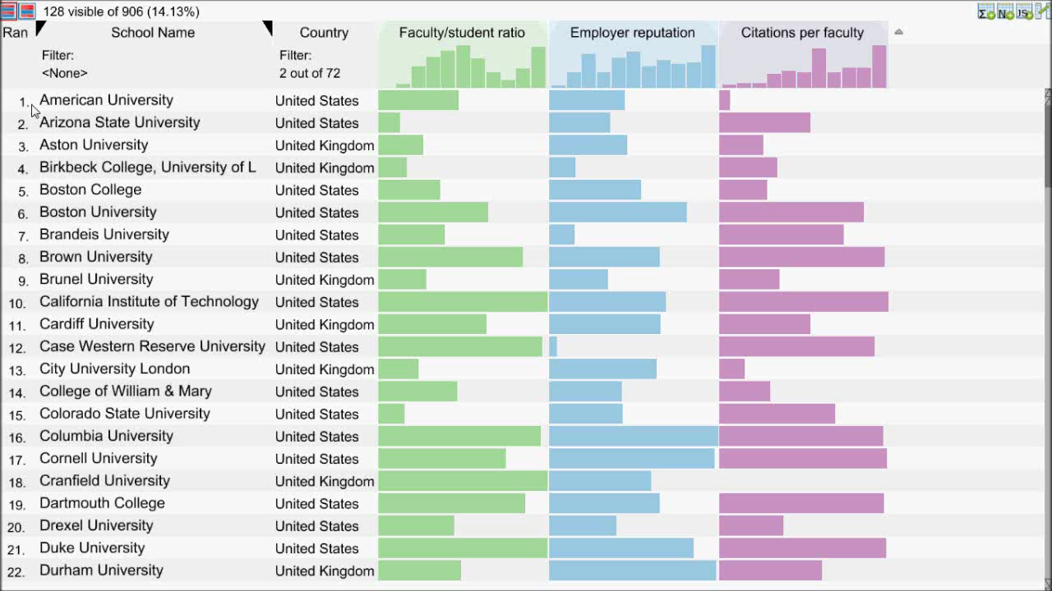
Video showing
Creating combined score
Sort by that
Change weights
Focus on animation: color & style

Slide 21
Flexible Mapping of
Attributes to Scores

Slide 22
0
1
Max
Min
100
0

Slide 23
0
1
0
100

Slide 24
0
1
0
100
Notes:
Evaluation has show -> more difficult to interpret

Slide 25
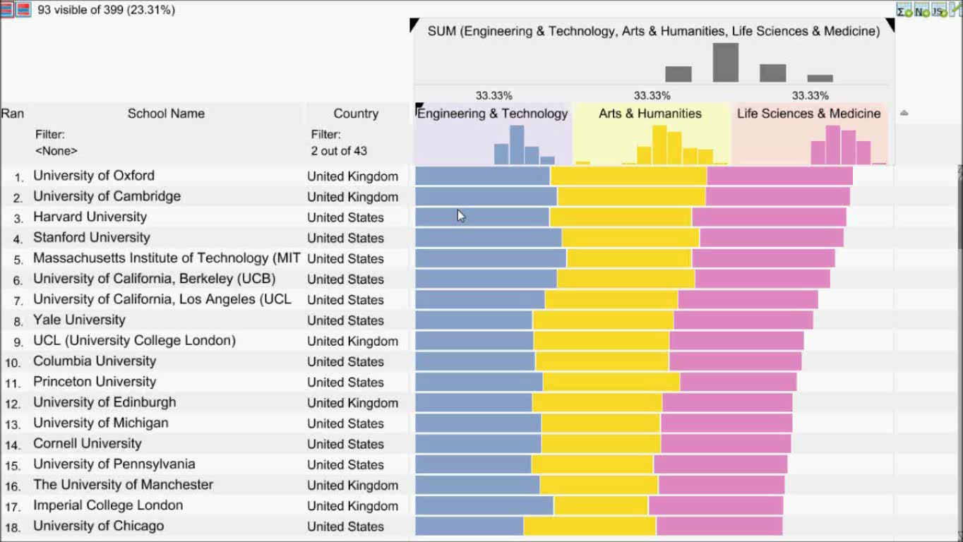
Video showing:
Scenario, manpulate mapping of attribute
Switch between two mode: hor / par
Add move points
Show java script editor
Apply A default one -> argument for compare

Slide 26
Compare Rankings
Compare Rankings

Slide 27
Bump Charts
Rank
University
Score
Rank
Score
Score
1.
MIT, USA
1.
2.
Harvard, USA
2.
(+1)
3.
Princeton, USA
3.
(+1)
4.
Cambridge, UK
4.
(-2)
5.
Oxford, UK
5.

Slide 28
Bump Charts
Rank
University
Score
Rank
Score
Score
1.
MIT, USA
1.
2.
Harvard, USA
2.
2.
Harvard, USA
(+1)
3.
Princeton, USA
3.
(+1)
4.
Cambridge, UK
4.
4.
(-2)
(-2)
5.
Oxford, UK
5.

Slide 29
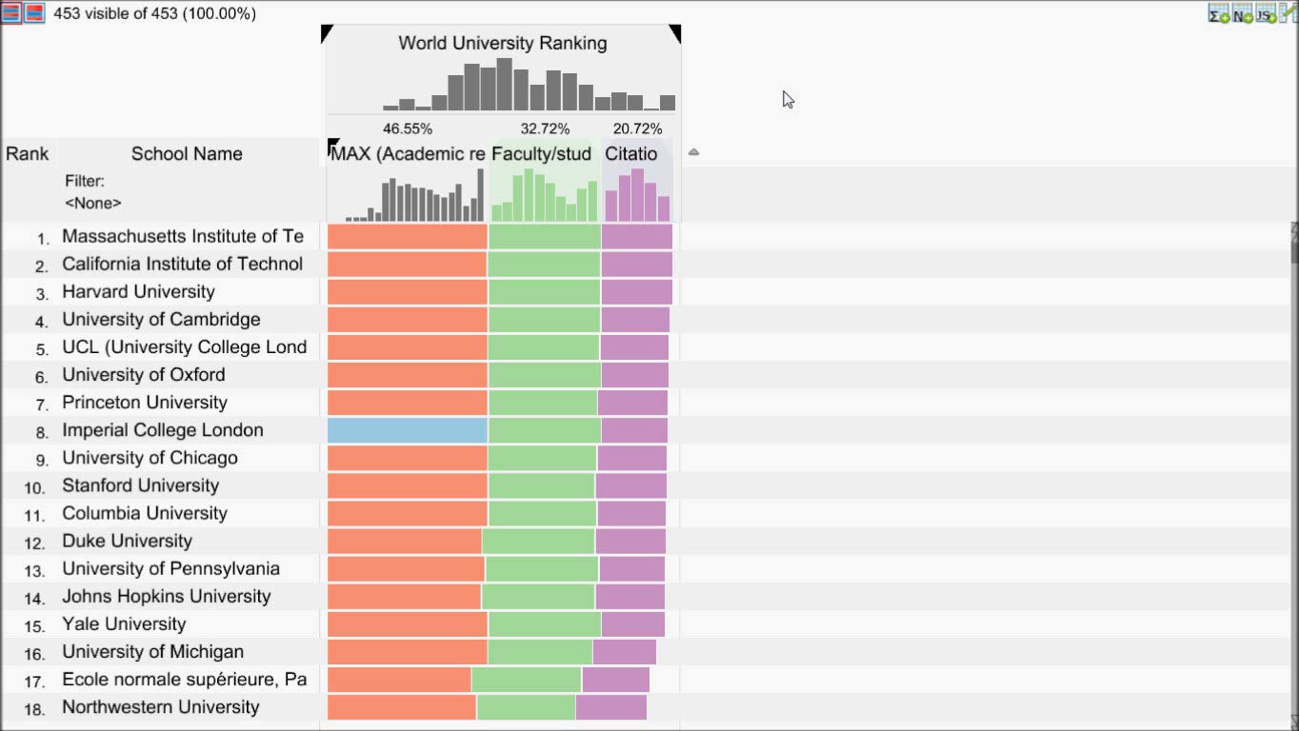
Video showing:
Creating snapshot for comparison
Play with weights
Show delta
Select by clicking on slopegraph

Slide 30
http://lineup.caleydo.org http://caleydo.github.io/lineup.js/

Slide 32
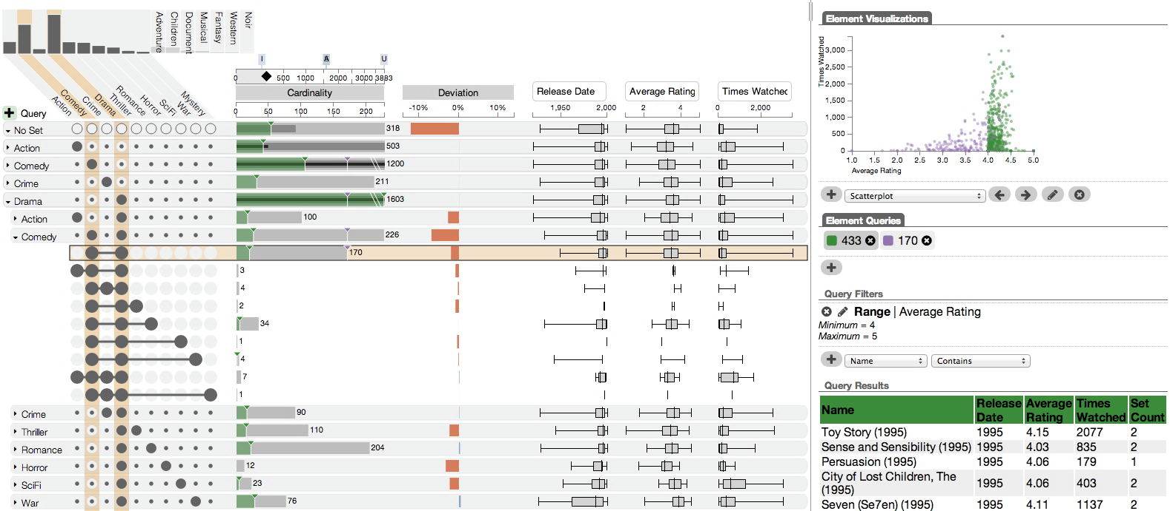
UpSet
Visualizing Intersecting Sets
[InfoVis’14]

Slide 33

School

Slide 34
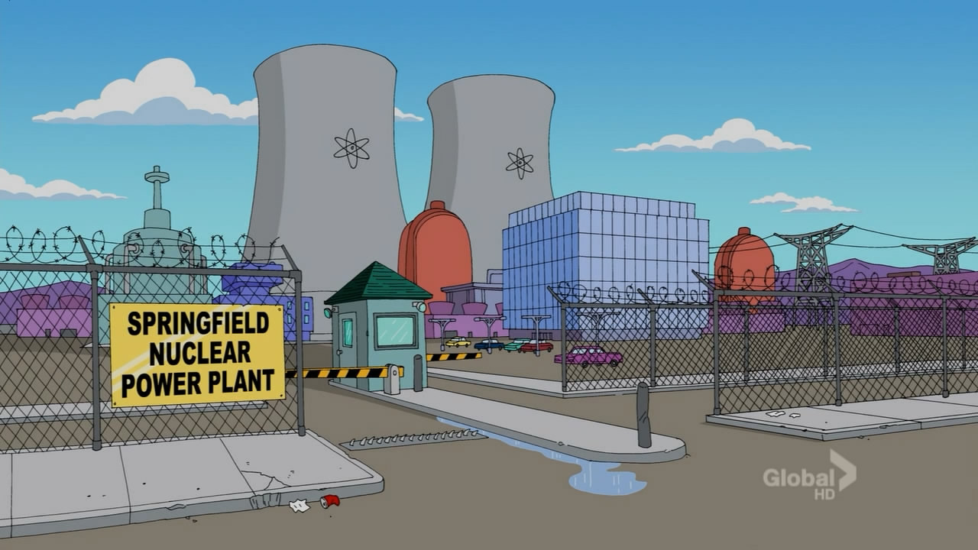
School
Power Plant

Slide 35


Evil
School
Power Plant

Slide 36
Evil
3
1
2
0
5
3
0
School
Power Plant

Slide 37
Evil
Blue Hair?
School
Power Plant

Slide 38
Evil
Blue Hair?
Duff Beer?
School
Power Plant

Slide 39
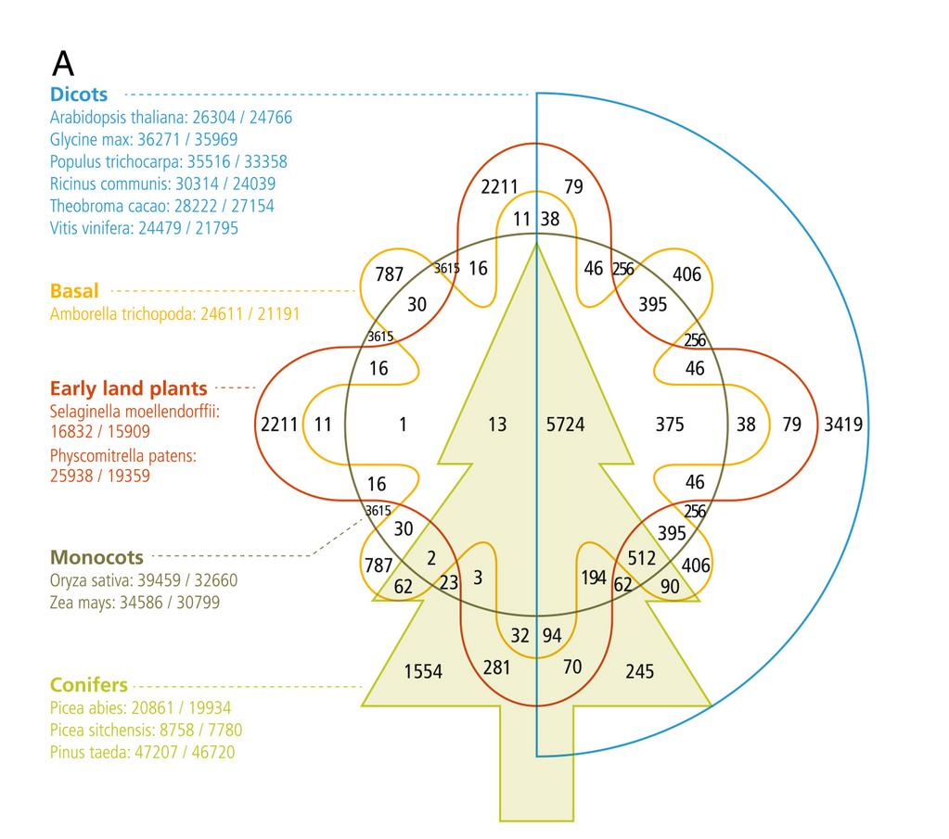
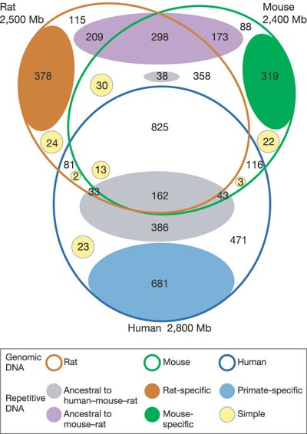
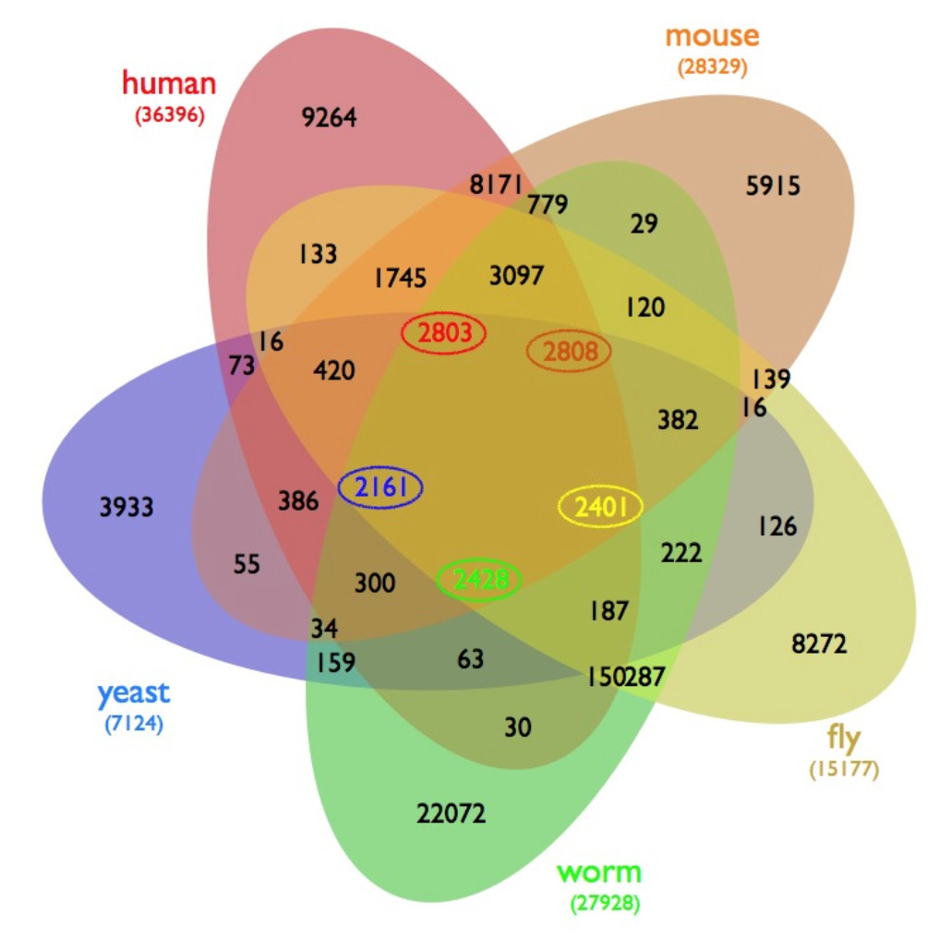
[Neale et al., BMC Genome Biology, 2014]
[Gibbs et al., Nature, 2004]
[D’Hont et al., Nature, 2012]
[Wiles et al., BMC Systems Biology]

Slide 40
[created with EulerAPE]

Slide 41
?
>
<
43
22
19
19
5
9
41
22
44
[created with EulerAPE]

Slide 42
Set Vis Goals
1. Efficient visual encoding
vs.
2. Creating complex
slices of a dataset
3. Visualize attributes

Slide 43
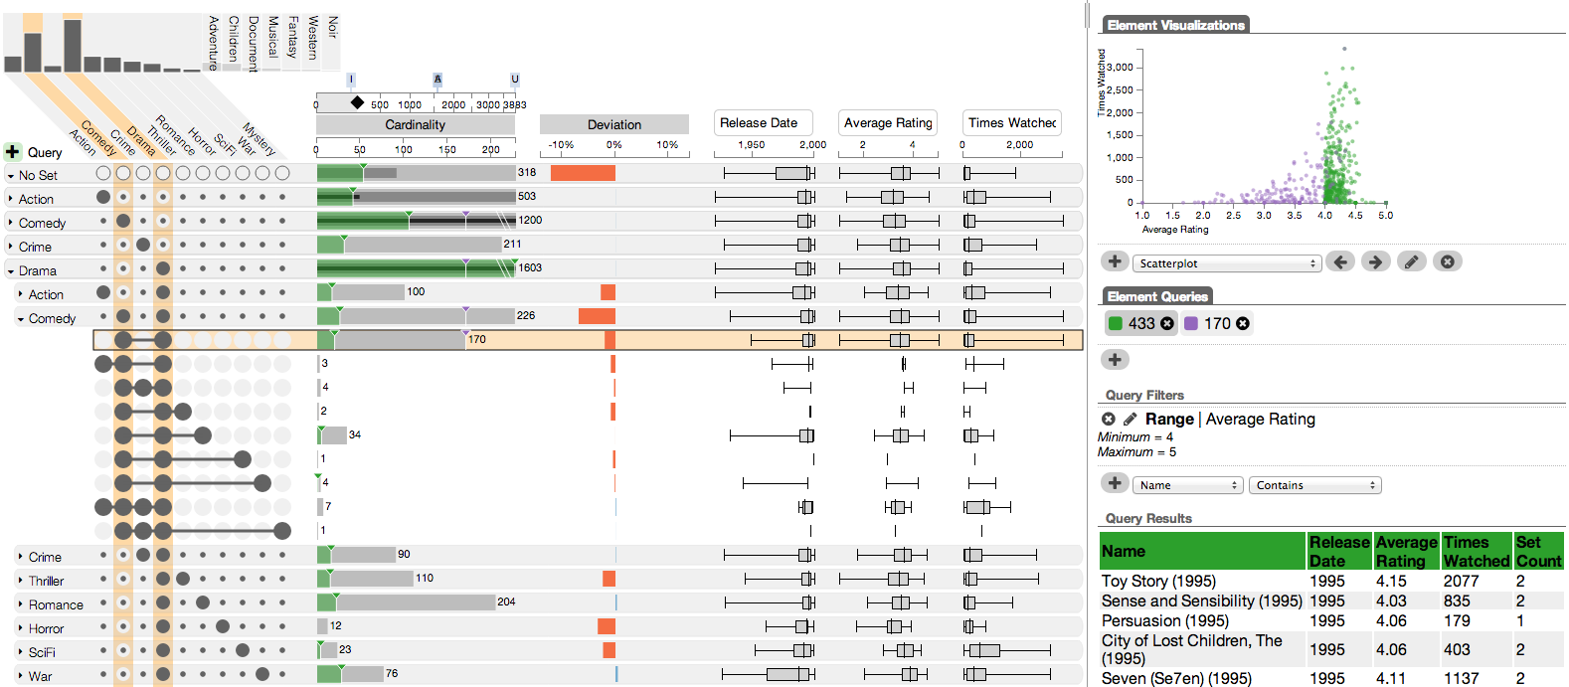
[Movie Lens Dataset]
Attribute Details
Visualizing Intersections
Visualizing Properties
Element List & Queries

Slide 44
Visualizing
Intersections

Slide 45
A
C
B
Universal Set
A
B
C

Slide 46
A
C
B
Must
Must Not
Universal Set
A
B
C

Slide 47
A
C
B
Cardinality
5
5
17
17
7
14
20
5
10
7
7
10
14
20
7
5

Slide 48
Plotting Attributes

Slide 49
A
How surprising is the size of an intersection?
C
B
What’s the distribution of an
attribute in an intersection?
Additional Plots
Deviation
Attributes

Slide 50
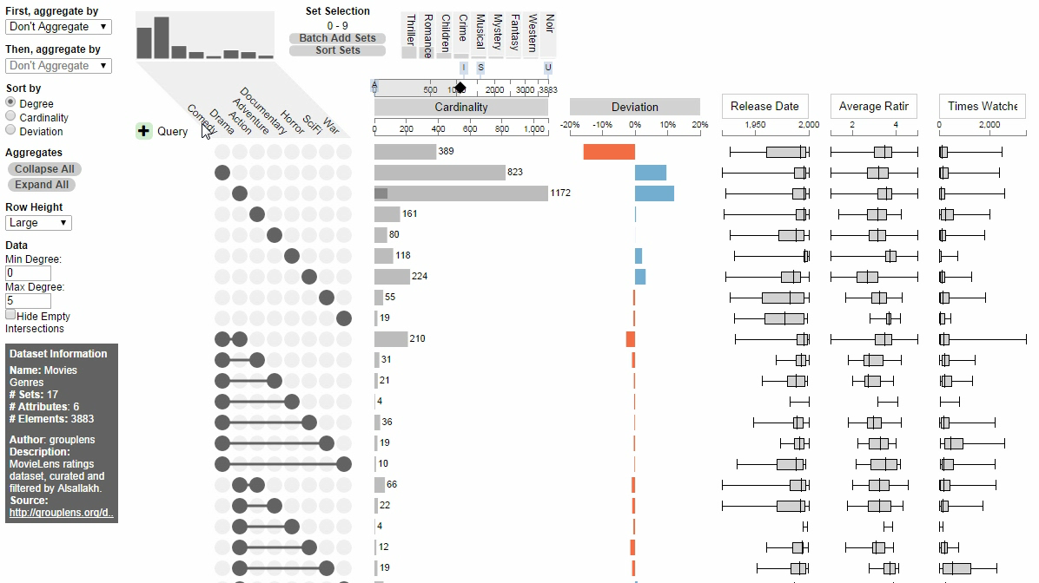

Drama-Comedy
Action-Comedy

Slide 51
Sorting

Slide 52
A
C
Which is the biggest intersection?
B
Sort By: Cardinality

Slide 53
A
C
Which is the most ‘surprising’ intersection?
B
Sort By: Deviation

Slide 54
A
What are the properties of the
intersections involving ‘A’?
C
B
Sort By: Set

Slide 55
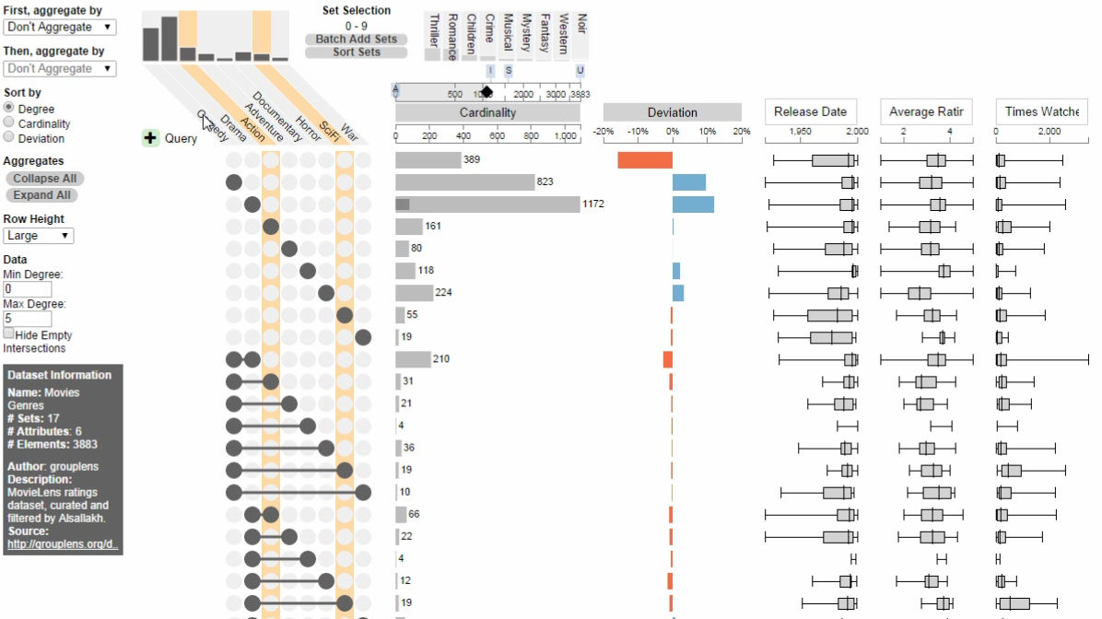

Slide 56
Aggregation

Slide 57
A
B
C
Are many items shared between
two sets?
Aggregate By: Degree

Slide 58
A
B
C
Are many items shared between
two sets?
Degree 0
Aggregate By: Degree
Degree 1
Sum of children
Degree 2
Degree 3

Slide 59
A
How are the elements of ‘B’ distributed?
B
C
Aggregate By: Set
Degree 0
Degree 1
Degree 2
Degree 3

Slide 60
A
How are the elements of ‘B’ distributed?
B
C
Aggregate By: Set
None
A
Must
May
Must Not
B
C

Slide 61
A
How are the elements of ‘B’ distributed?
B
C
Aggregate By: Set
None
A
B
C

Slide 62
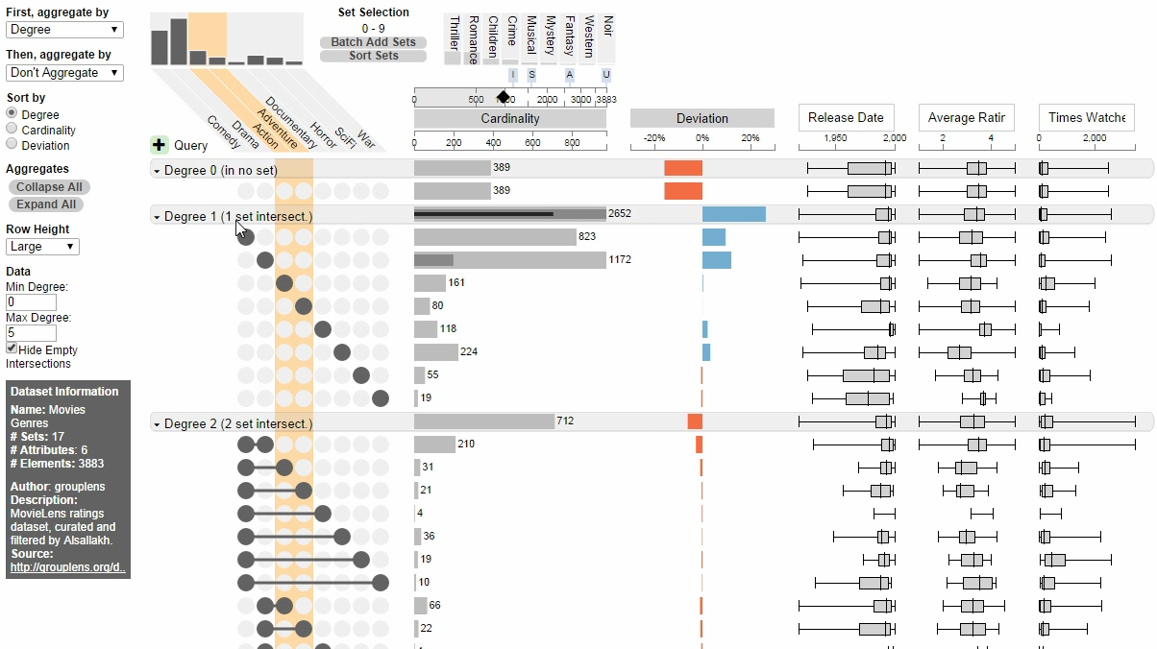

Slide 63
Queries

Slide 64
A
B
C
Must
May
Must Not

Slide 65
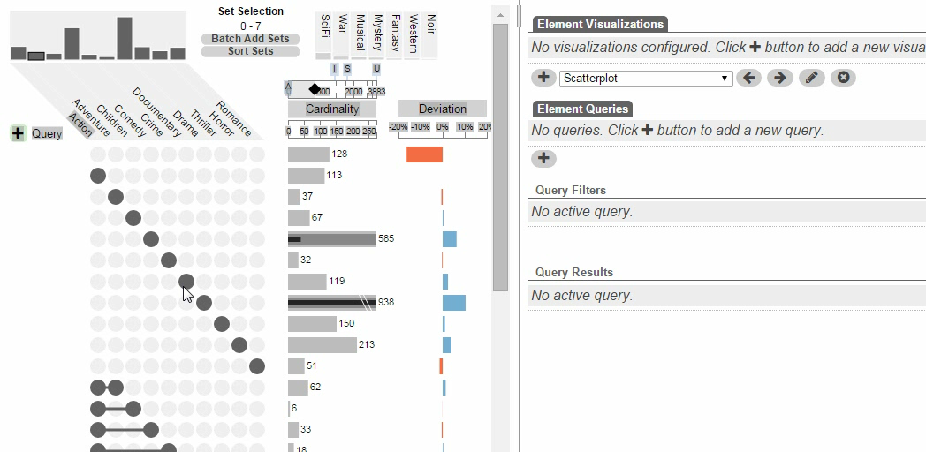

Slide 66
Elements & Attributes

Slide 67
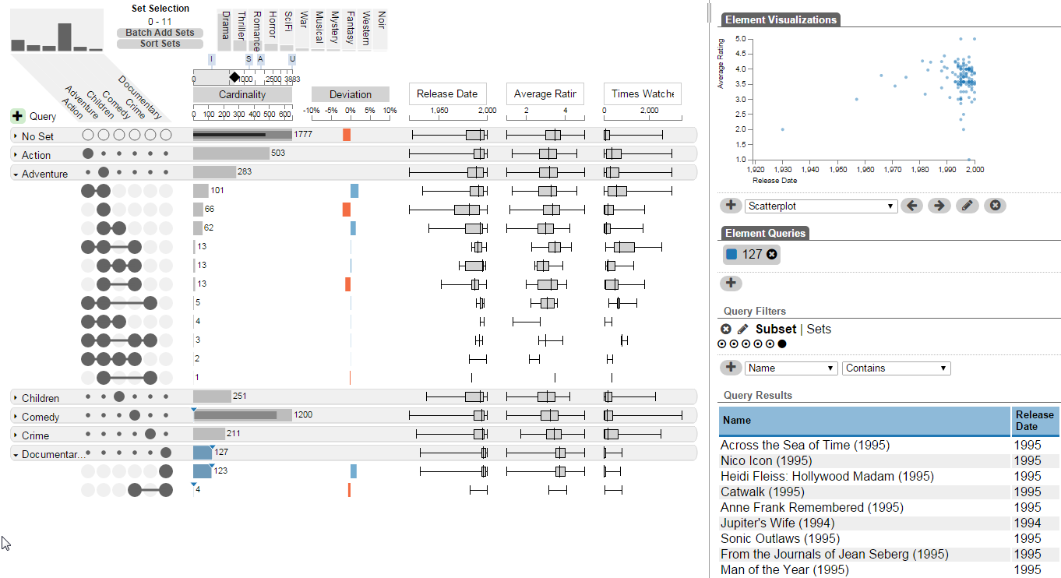
How do documentaries compare to adventure movies?

Slide 68
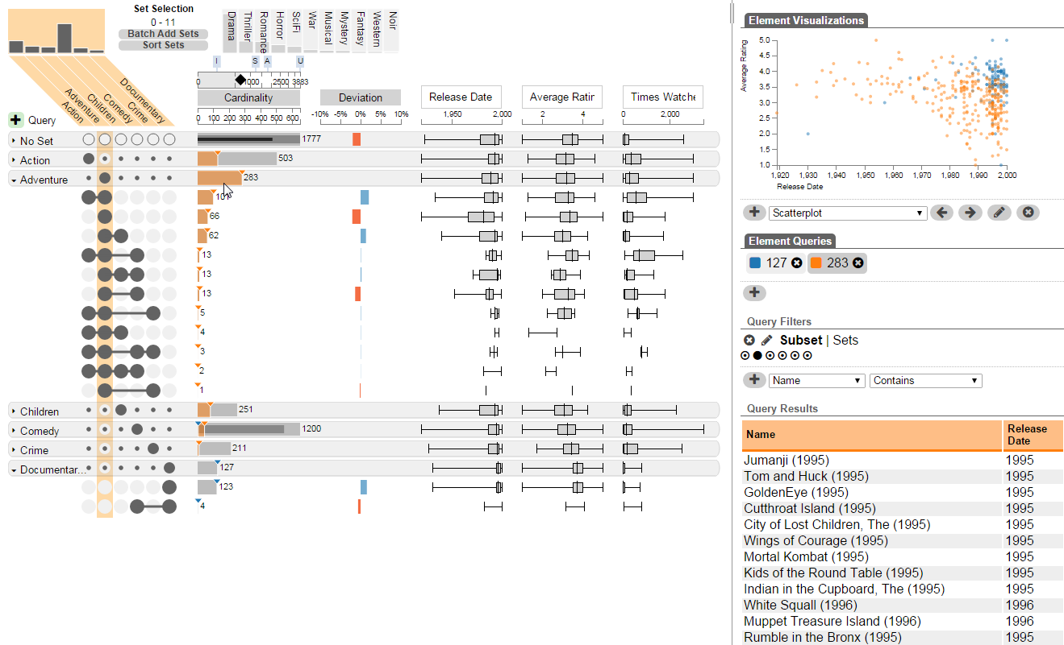
How do documentaries compare to adventure movies?

Slide 69
Applications

Slide 70
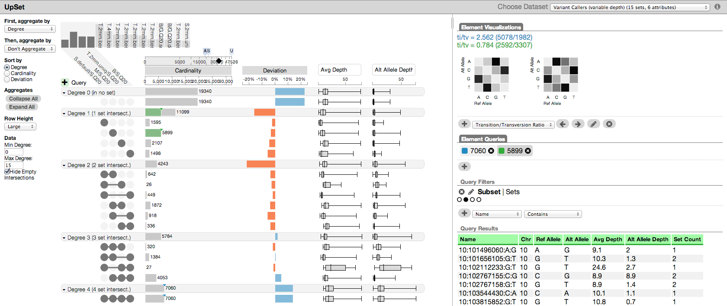
Applications
Genetics
Economics
Pharmacology
Social Networks

Slide 71
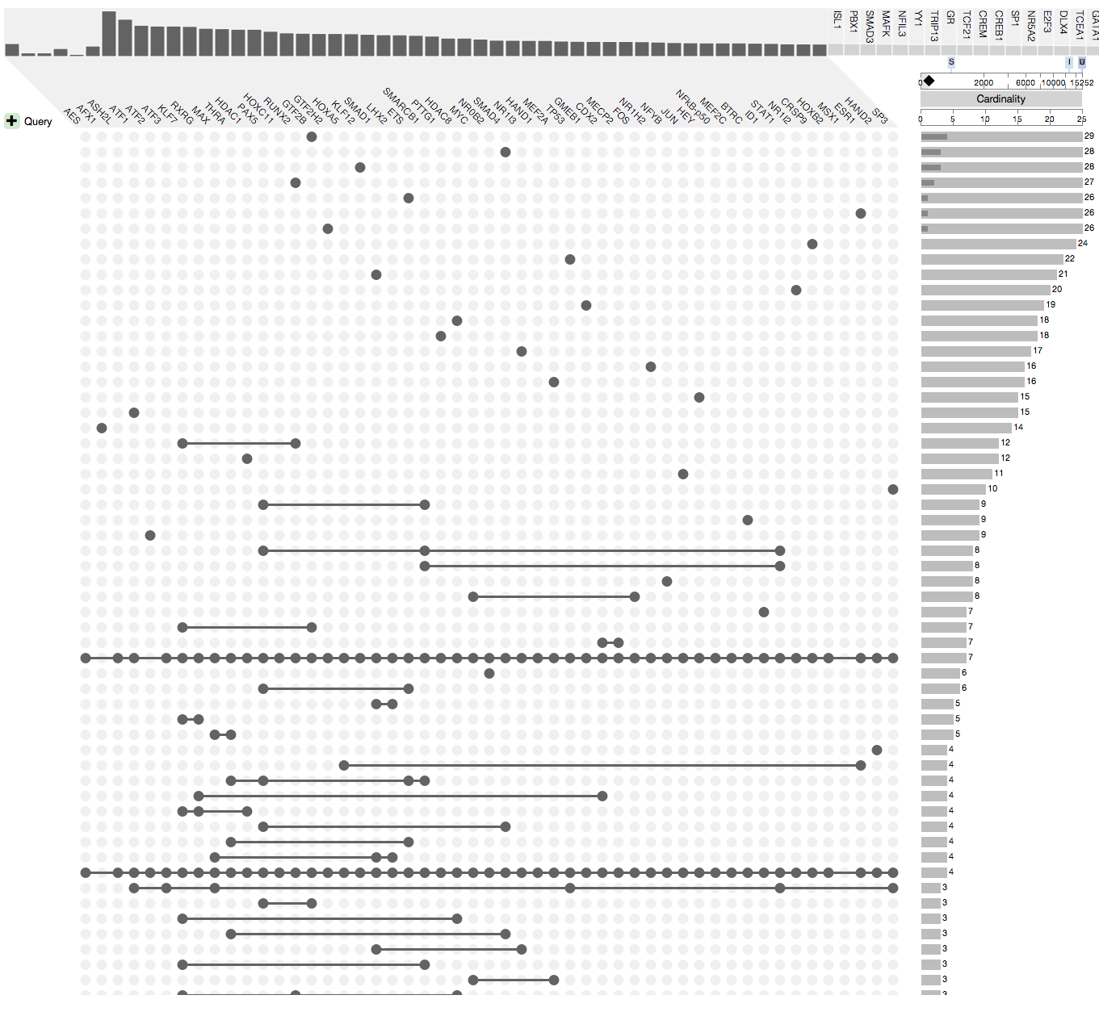
Scalability
Comfortable: ~15 sets
Possible: ~40 sets
Scales with the number of
non-empty intersections
  Most datasets are sparse

Slide 72

Deviation Measure
Expected if A and B independent
A
50%
A $∩$ B
25%
B
50%
Observed 1
40%
> then expected
Observed 2
10%
< then expected
[Alsallakh 2013]

Slide 73
http://vcg.github.io/upset

Slide 75
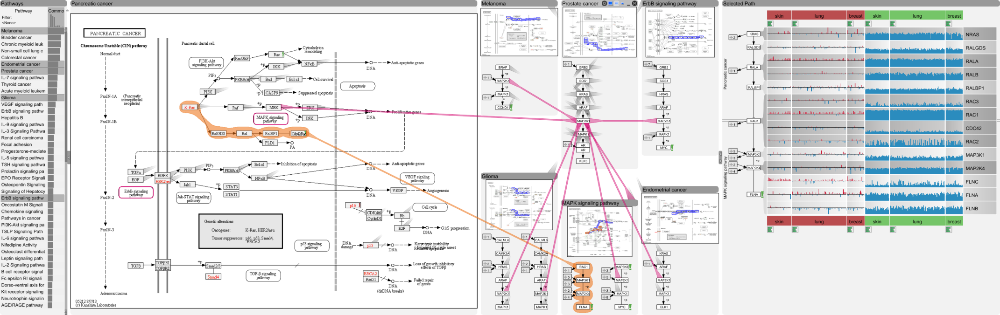
Pathways
[Partl, BioVis ‘12]
Best Paper Award
[Partl, BMC Bioinf. ‘13]
[Lex, InfoVis ‘13]

Slide 76
Publications
Alexander Lex, Christian Partl, Denis Kalkofen, Marc Streit, Anne Mai Wasserman, Samuel Gratzl, Dieter Schmalstieg and Hanspeter Pfister
Entourage: Visualizing Relationships between Biological Pathways using Contextual Subsets
IEEE TVCG (InfoVis '13), 2013
Christian Partl, Alexander Lex, Marc Streit, Denis Kalkofen, Karl Kashofer and Dieter Schmalstieg
enRoute: Dynamic Path Extraction from Biological Pathway Maps for Exploring Heterogeneous Experimental Datasets
BMC Bioinformatics, 2013
Christian Partl, Alexander Lex, Marc Streit, Denis Kalkofen, Karl Kashofer, Dieter Schmalstieg
enRoute: Dynamic Path Extraction from Biological Pathway Maps for In-Depth Experimental Data Analysis
BioVis, 2012
Best Paper Award

Slide 77
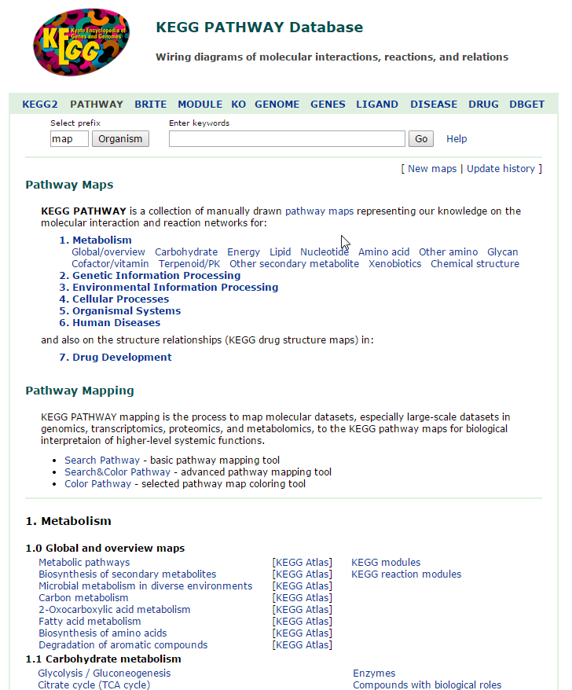
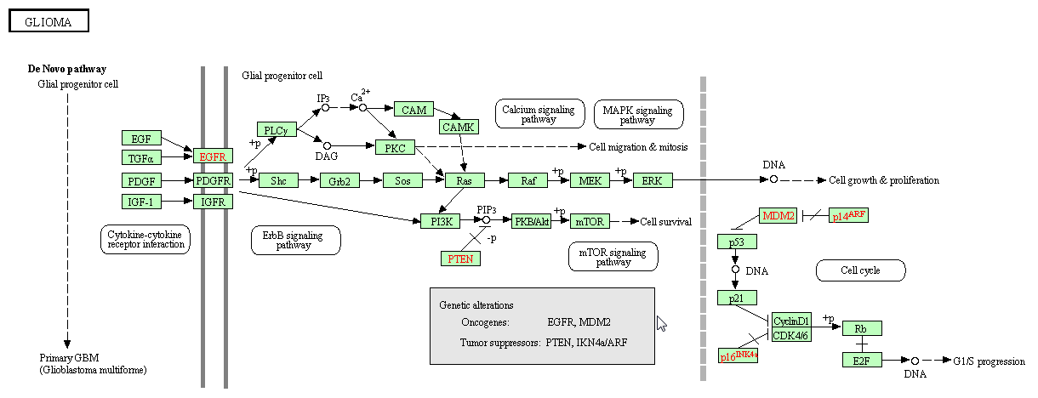
A Pathway

Slide 78
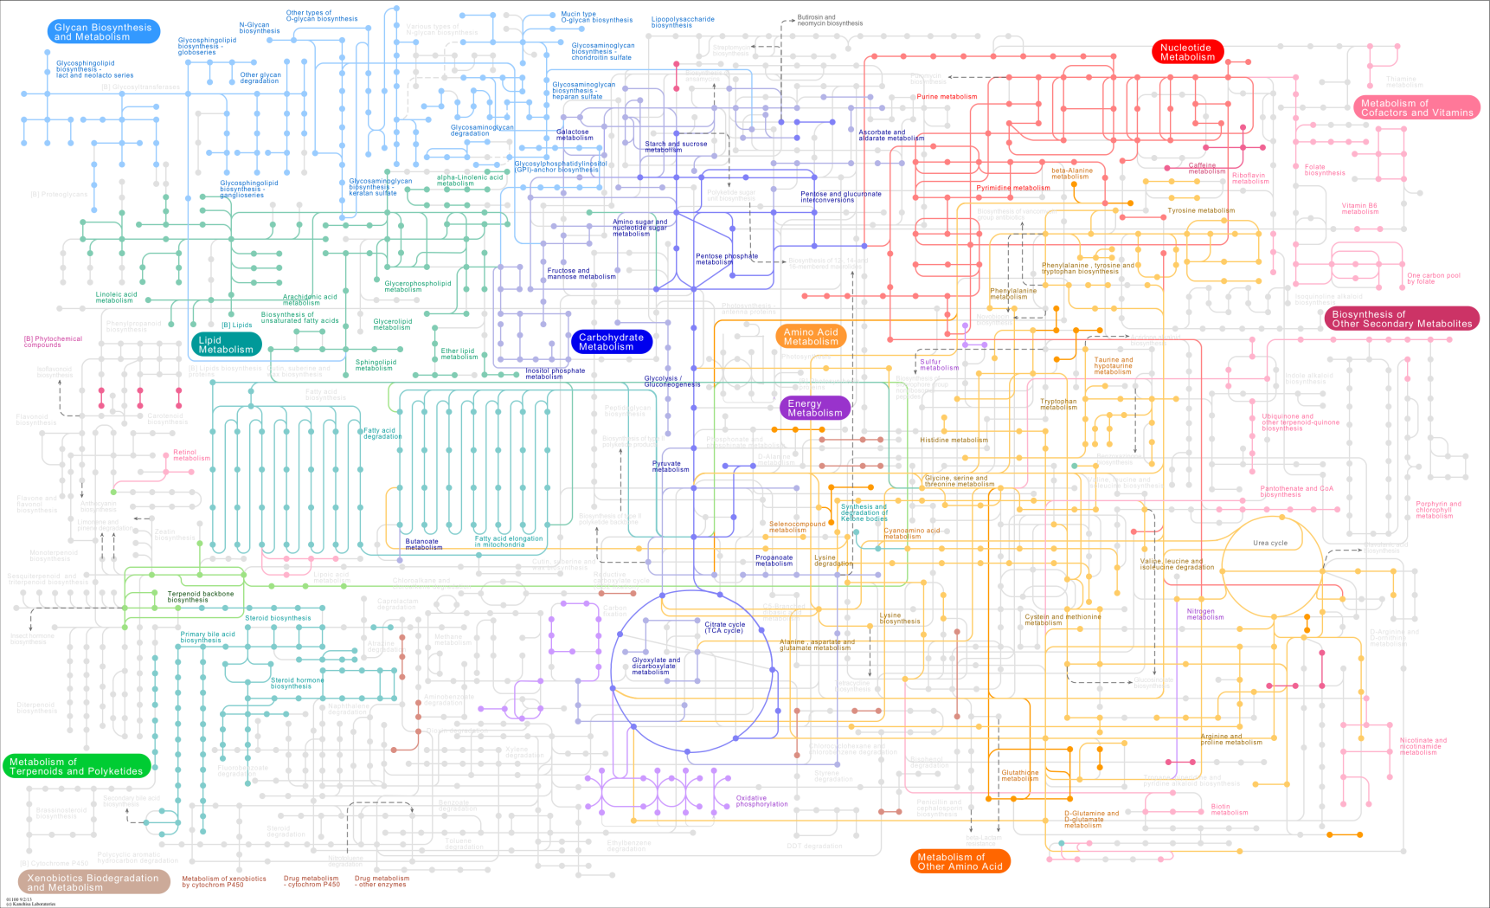
The bigger picture

Slide 79
Background
Whole Network
Pathway A
B
Pathway B
Pathway C
D
I
A
E
C
C
H
J
G
L
F
G
L
P
N
K
Q
M
O

Slide 80
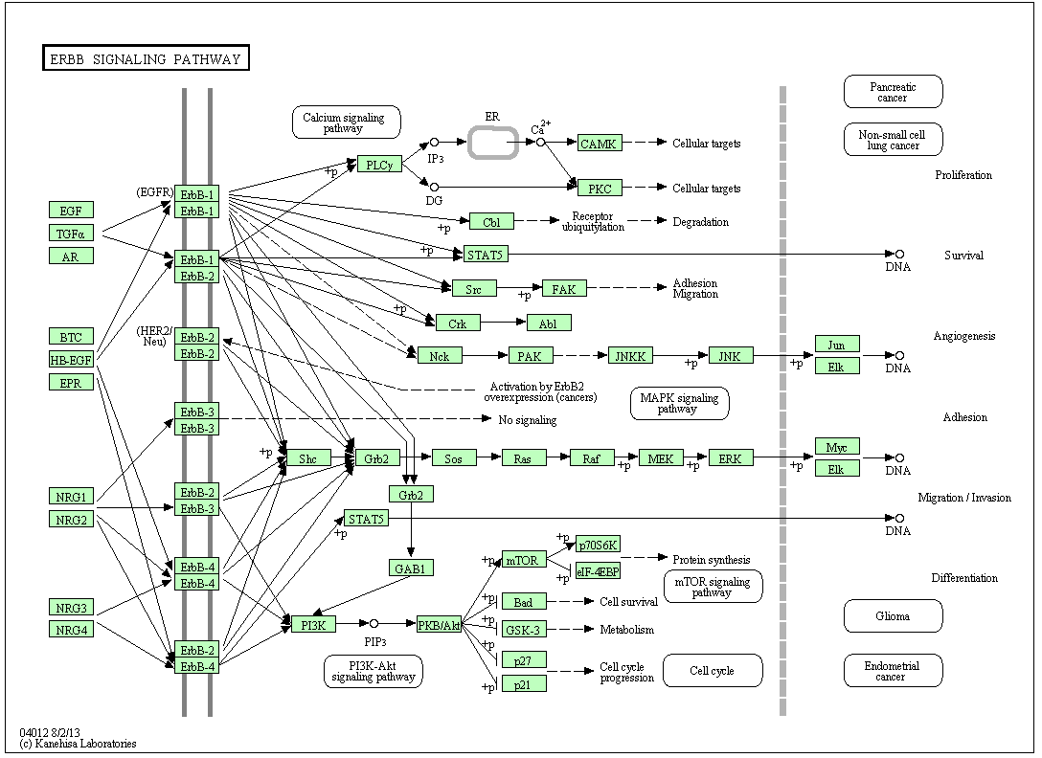
A Pathway

Slide 81
Two Problems - Two Solutions
1. Large Partitioned Network
2. Many Node Attributes

Slide 82

Large Partitioned Network
Pathway A
Pathway B
B
D
G
G
L
Drug side-effects
A
E
C
P
N
Drug repositioning
M
O
G
F
G

Slide 83
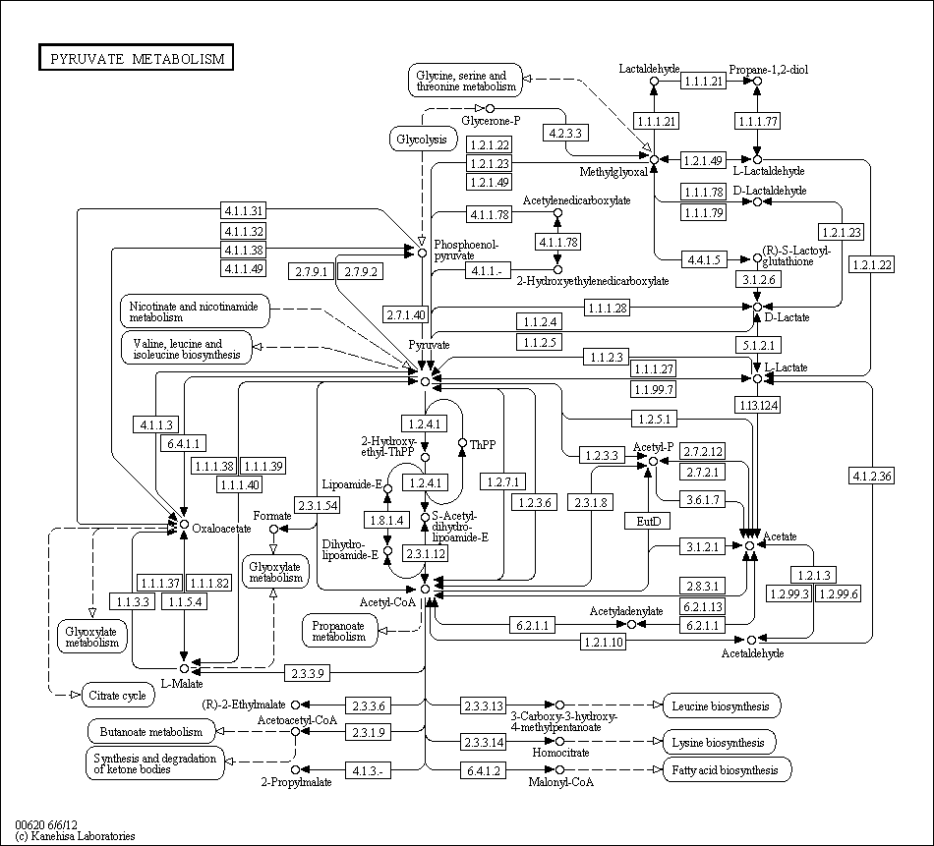
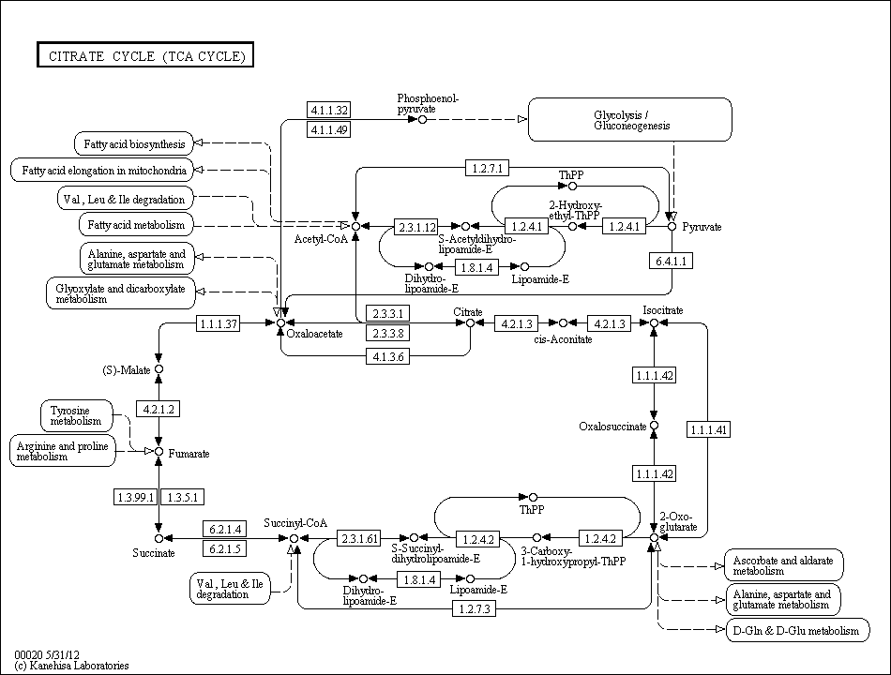
Large Partitioned Network
How to visualize pathway relationships?

Slide 84
Many Node Attributes
Pathway A
Node
Sample 1
Sample 2
Sample 3
…
A
0.55
0.95
0.83
…
B
D
B
0.12
0.42
0.16
…
C
0.33
0.65
0.38
…
A
…
…
…
…
E
C
C
Node
Sample 1
Sample 2
Sample 3
…
A
low
low
very high
…
F
G
B
normal
low
high
…
How to visualize experimental data on pathways?
C
high
very low
normal
…
…
…
…
…

Slide 85
Visualizing
Large Partitioned Networks

Slide 86
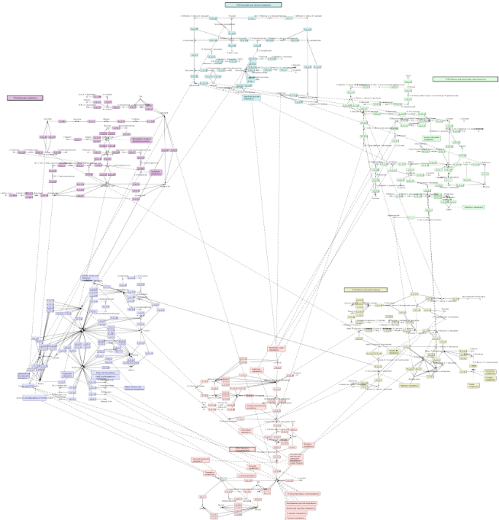
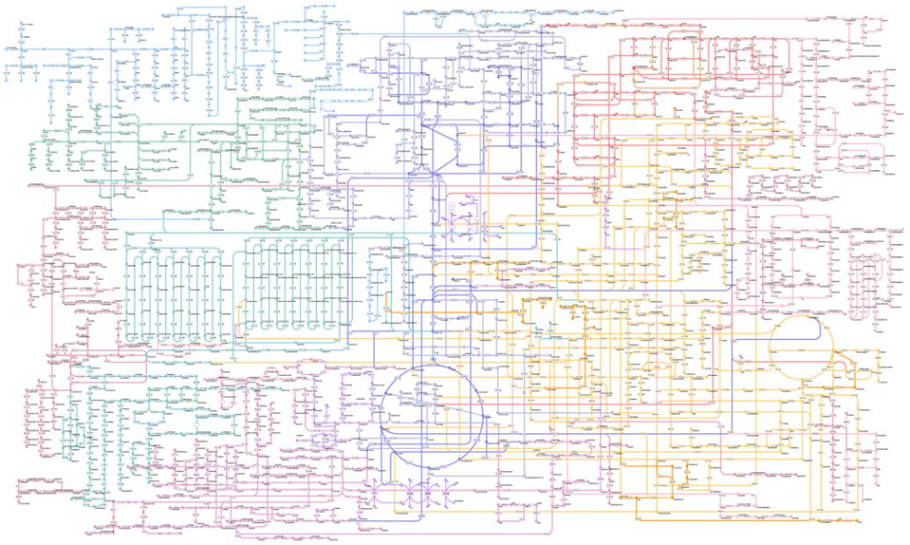
Approaches
Whole Network
Connected Pathways
[Kono2009]
[Klukas2006]

Slide 87
Step 1: Finding Related Pathways

Slide 88
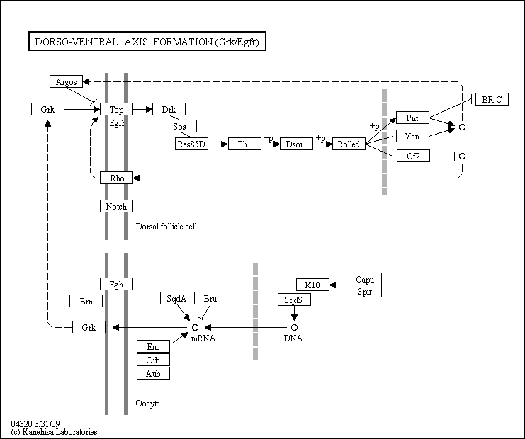
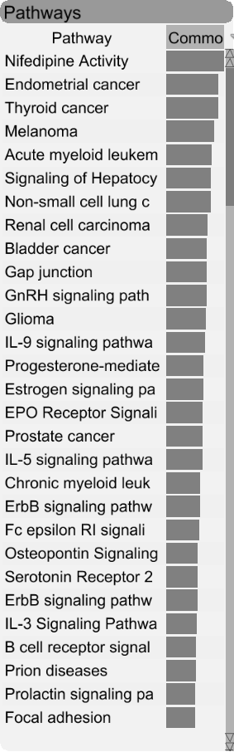
Finding Related Pathways

Slide 89
Step 2: Managing Display Space
Pathway A
Pathway B
A
G
A
G
A
PW B
B
A
G
A
C
A
E
H
A
R
D
H
I
J
I
F
I
Contextual Subset
Focus Pathway
Context Pathway

Slide 90
Step 2: Managing Display Space
Pathway A
A
A
A
PW D
PW C
PW B
M
B
B
C
G
P
E
E
A
R
D
K
H
L
N
I
F
Focus Pathway
Context Pathways

Slide 91
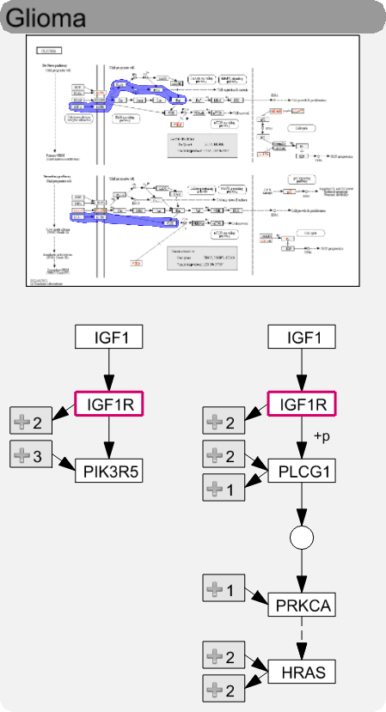
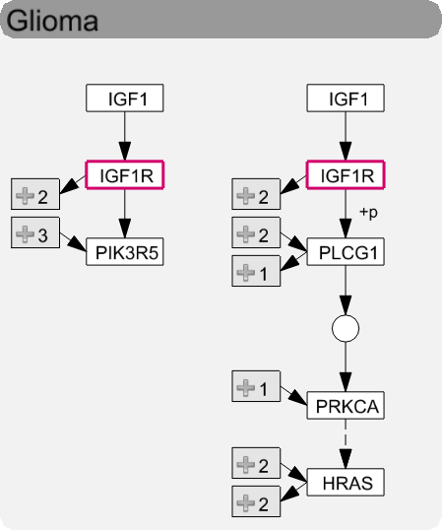
Levels of Detail
High
Medium
Low

Slide 92
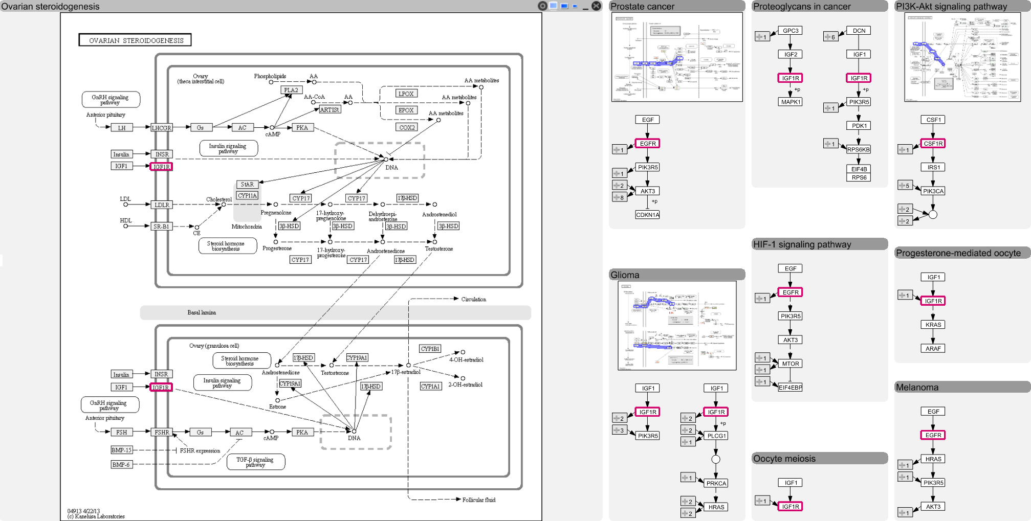
Layout

Slide 93
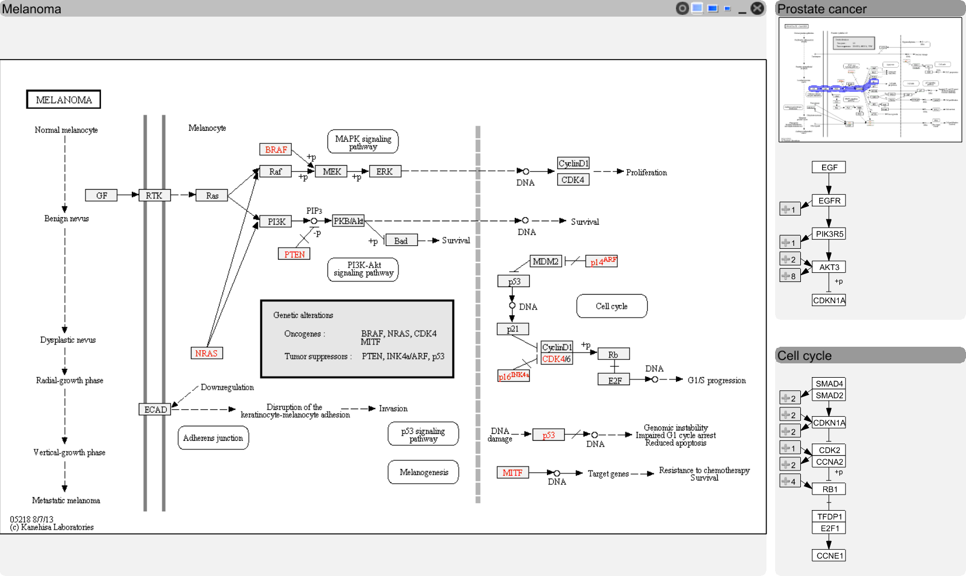
Step 3: Visualizing Relationships

Slide 94
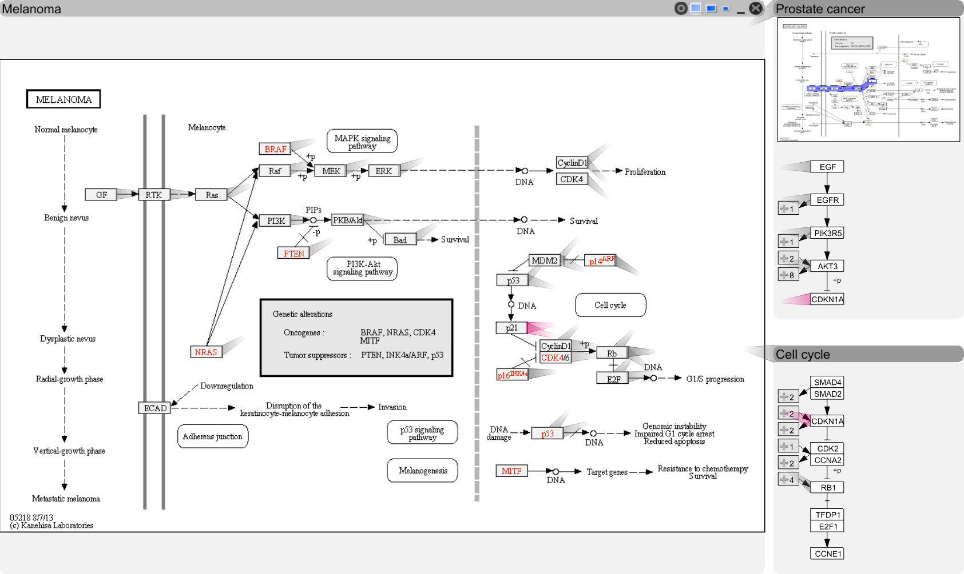
Step 3: Visualizing Relationships

Slide 95
Step 3: Visualizing Relationships

Slide 96

Step 3: Visualizing Relationships

Slide 97

Step 3: Visualizing Relationships

Slide 98

Step 3: Visualizing Relationships

Slide 99

Video
Notes:
Seiteneffekte über portal -> sprung zurück zu goals, pharmacological data raus

Slide 100
Visualizing
Many Node Attributes

Slide 101
Experi-mental Data and Pathways
Cannot account for variation found in
real-world data
Branches can be (in)activated due to
  mutation,
  changed gene expression,
  modulation due to drug treatment,
  etc.
[Partl, BioVis ‘12]

Slide 102

Good Old Color Coding
A -3.4
B 2.8
C 3.1
D -3
E 0.5
F 0.3
4.2 5.1 4.2
1.8 1.3 1.1
-2.2 2.4 2.2
-2.8 1.6 1.0
0.3 -1.1 1.3
0.3 1.8 -0.3
B
A
C
D
E
F
[Lindroos2002]

Slide 103
Challenge: Data Scale & Heterogeneity
Large number of experiments
  Large datasets have more than 500 experiments
Multiple groups/conditions
Different types of data

Slide 104

Challenge: Supporting Multiple Tasks
B
Two central tasks:
  Explore topology of pathway
  Explore the attributes of the nodes
  (experimental data)
Need to support both!
A
C
D
E
F

Slide 105

Inspiration
[Meyer 2010]

Slide 106
Concept
Pathway View
enRoute View
B
Non-Genetic Dataset
A
A
B
C
A
C
D
D
D
E
E
E
F
F
Group 1
Dataset 1
Group 2
Dataset 1
Group 1
Dataset 2

Slide 107



enRoute

Slide 108
Video

Slide 109


Slide 110
Case Study: CCLE Data
22

Slide 111


Slide 112
http://entourage.caleydo.org

Slide 114


Other Techniques
Creating Integrated
Visualizations from Subsets
Visualizing Hidden Content
IEEE TVCG (InfoVis '14)
HONORABLE MENTION AWARD
ACM CHI’14
HONORABLE MENTION AWARD

Slide 115



Other Domain Problem Projects
Heterogeneous Datasets
Cancer Subtype Analysis
Faceted Browsing of Graphs
Drug Discovery
Protein Sequence
Analysis
Nature Methods, 2014
CG & A 2014
EuroVis 2012
3rd Best Paper
IEEE TVCG (VAST '14)
BMC Proceedings 2014

Slide 116


http://caleydo.org

Slide 117
Research Challenges

Slide 118
Interacting with Data
The Future of Data Analysis
is (also) Interactive
Communicates
Interfaces
Selected &
Derived Data
Visualization
Human
Computation
Interaction
Insight
Actions
Context
Reasoning
Algorithms
Statistics
Recommendations
Classifications
Aggregation
Data
Informative,
Incomplete,
Noisy, Conflicting

Slide 119

Can we make creating interactive vis systems easier?
Right now: prerogative of skilled software developers
Goal: democratize the creation of visualizations

Slide 120

How can we scale to increasingly big datasets?
No local copies of datasets
No in-memory processing
….
Approach:
  Automatic slicing into subsets
  Query or explore ranked subsets
  Pull in relationships for subset

Slide 121
Solve Important Domain Problems
Some problems too specific for general methods
High impact when solving them
Inspiration for research

Slide 122
Enabling Scientific Discovery through Interactive Visual Data Analysis
Alexander Lex
@alexander_lex
http://alexander-lex.com
University of Utah
Scientific Computing Institute
December 3, 2014
?
Credits:
Marc Streit, Nils Gehlenborg, Christian Partl, Samuel Gratzl, Markus Steinberger, Manuela Waldner, Hendrik Strobelt, Romain Vuillemot, Dieter Schmalstieg, Denis Kalkofen, Mark Borowsky, Anne Mai Wasserman, Hanspeter Pfister

